Slide 1

Data Communication and Computer Network BLM3051
Dr. Öğr. Üyesi Furkan ÇAKMAK

Slide 2

Lecture Information Form - Weekly Subjects
BLM3051
Data Communication and Computer Network - 7
Hafta | Tarih | Konular
1 | 20.02.2024 | Introduction to Data Communication Standards Used on Data Communication, Architectural models
2 | 27.02.2024 | OSI Reference Model , Layers and Their Functions, Signaling and Signal Encoding
3 | 05.03.2024 | Parallel and Serial Transmission, Communication Media and Their Technical Specs., Multiplexing (TDM, FDM)
4 | 12.03.2024 | Error Detection and Error Correction Techniques, Data Link Control Techniques, Flow Control
5 | 19.03.2024 | Asynchronous and Synchronous Data Link Protocols (BSC, HDLC)
6 | 26.03.2024 | LAN Technologies Continued, IEEE 802.4, 802.5, 802.11
7 | 02.04.2024 | Connectionless and Connection Oriented Services, Switching
8 | 09.04.2024 | Tatil – Ramazan Bayramı Arifesi
9 | 16.04.2024 | 1. Ara Sınav
10 | 23.04.2024 | Tatil – 23 Nisan Ulusal Egemenlik ve Çocuk Bayramı
11 | 30.04.2024 | Static and Dynamic Routing, Congestion in the Network Layer, Its Causes and Solutions
12 | 07.05.2024 | IP (Internetworking Protocol), ICMP, BOOTP, DHCP
13 | 14.05.2024 | 2. Ara Sınav
14 | 21.05.2024 | UDP (User Datagram Protocol), TCP (Transmisson Control Protocol)
Dr. Öğr. Üyesi Furkan ÇAKMAK

Slide 3
Network Layer
BLM3051
Data Communication and Computer Network - 7
Delivering packets from the source all the way to the destination
Making many hops at intermediate routers
This function clearly contrasts with that of the data link Layer.
Lowest layer that deals with end-to-end transmission
The network layer must know about the topology of the network (i.e., the set of all routers and links)
Choose appropriate paths through it
7 | Application Layer
6 | Presentation Layer
5 | Session Layer
4 | Transport Layer
3 | Network Layer
2 | Data Link Layer
1 | Physical Layer
Dr. Öğr. Üyesi Furkan ÇAKMAK

Slide 4
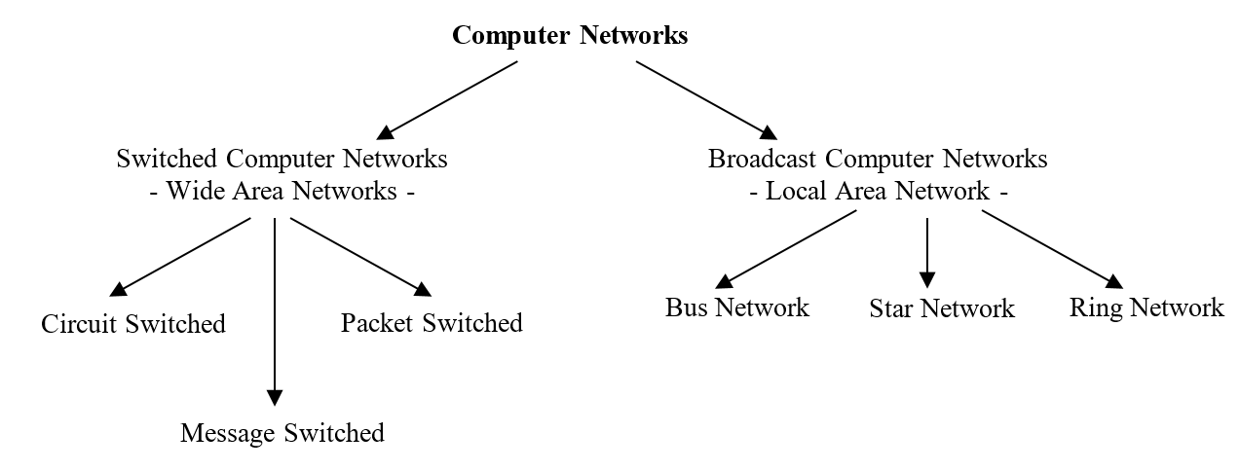
Network Layer - Switching
BLM3051
Data Communication and Computer Network - 7
Dr. Öğr. Üyesi Furkan ÇAKMAK

Slide 5
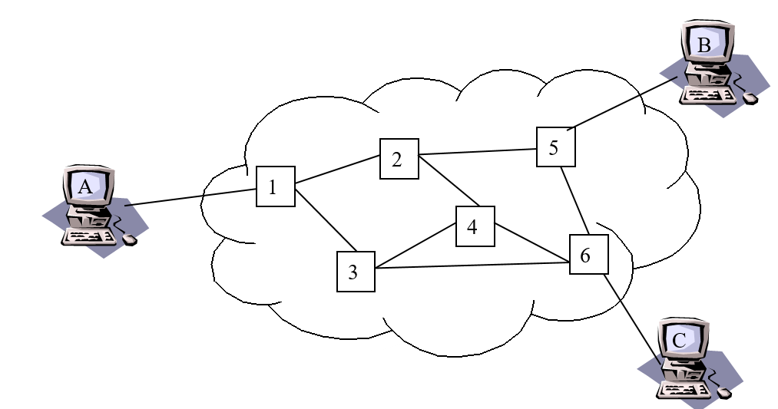
Network Layer - Circuit Switching
BLM3051
Data Communication and Computer Network - 7
End office (switchboard)
Subscriber loop
It is possible to establish more than one connection using TDM and/or FDM techniques on the connections between intermediate switching elements.
Trunk
Circuit Switched Networks
Space Division Circuit Switching
Time Division Circuit Switching
Dr. Öğr. Üyesi Furkan ÇAKMAK

Slide 6
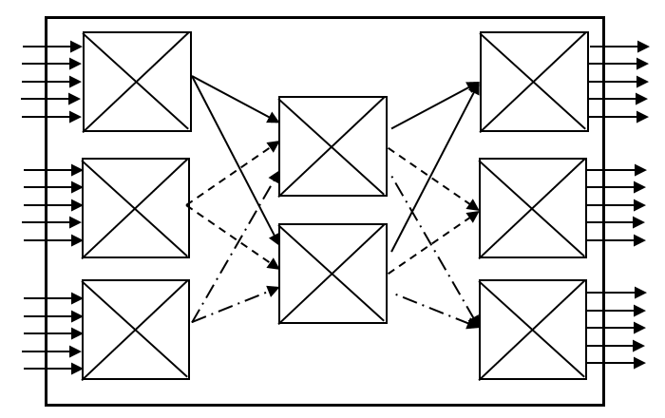
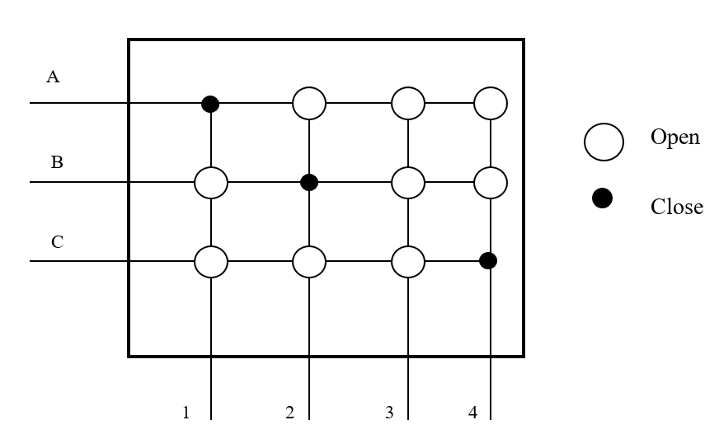
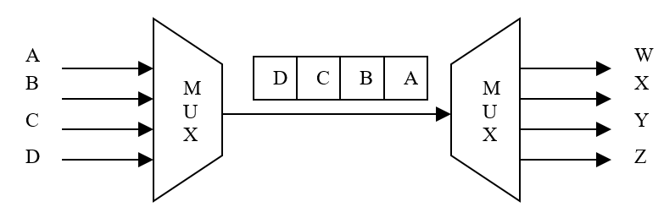
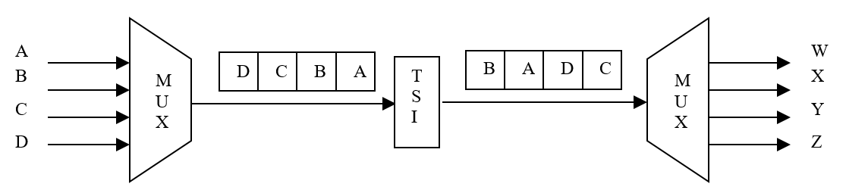
Network Layer – Circuit Switching (Con’t)
BLM3051
Data Communication and Computer Network - 7
Space Division Circuit Switching
Design for analogue telephone networks
Cross-Bar
Multistage switch
Time Division Circuit Switching
TDM
TSI (Time Slot Interface)
Hybrid switching
TST (Time-Space-Time)
TSST (Time-Space-Space-Time)
STTS (Space-Time-Time-Space)
Control Signalin
Dr. Öğr. Üyesi Furkan ÇAKMAK

Slide 7
Network Layer – Package Switching
BLM3051
Data Communication and Computer Network - 7
Circuit Switching is more suitable for telephone infrastructure.
A payment is necessary as long as the connection continues
Not suitable for bursty traffic
Package Switching
Pricing is based on the amount of information sent rather than the connection time
Enabling to provide additional capacity needed for traffic bursts that may occur at different times
Adaptive
Dr. Öğr. Üyesi Furkan ÇAKMAK

Slide 8
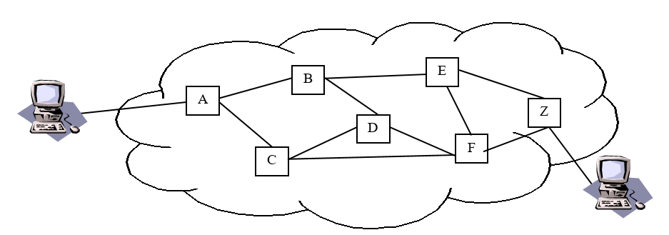
Network Layer – Package Switching (Con’t)
BLM3051
Data Communication and Computer Network - 7
Datagram
Traditional Mail Delivering System
Routing Table
Suitable for transmission of a small number of packets.
Virtual Circuit-VC
Switched Virtual Circuit-SVC
The first packet sent determines the route
VCI-Virtual Channel Identifier
Permenant Virtual Circuit-PVC
CI (Channel Identifier)
Dr. Öğr. Üyesi Furkan ÇAKMAK

Slide 9
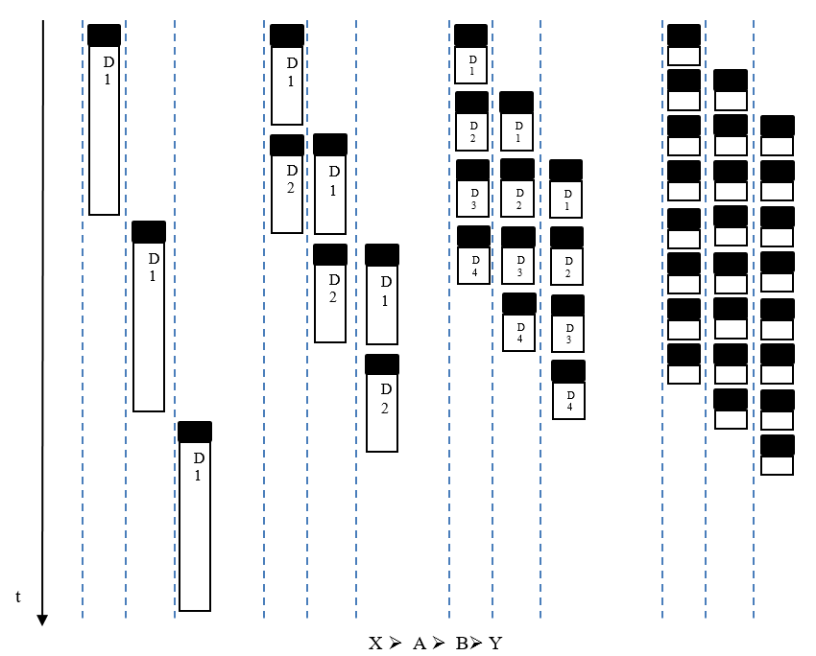
Effect of Package Size on Performance
BLM3051
Data Communication and Computer Network - 7
Dr. Öğr. Üyesi Furkan ÇAKMAK

Slide 10
Comparison of Circuit and Packet Switched Networks
BLM3051
Data Communication and Computer Network - 7
In circuit-switched networks, increased traffic causes some calls to be blocked and new connections not to be accepted.
On the other hand, in packet-switched networks, even if traffic increases (up to a certain level), packets will be accepted, but delivery times will be longer.
In case of congestion, it is possible for nodes on the network to continue functioning by discarding some packets.
Packets that are discarded and cannot be delivered to the recipient must be followed by higher-level protocols running at the transport layer.
In packet-switched networks, node-to-node connections are shared by many packets over time.
When necessary, packets are also kept in queues created in the buffer memory area used in intermediate nodes.
Since simultaneous TDM is used in circuit-switched networks, the connection between the two nodes must be pre-allocated.
Dr. Öğr. Üyesi Furkan ÇAKMAK

Slide 11
Comparison of Circuit and Packet Switched Networks (Con’t)
BLM3051
Data Communication and Computer Network - 7
In packet switching networks, each station is connected to switching elements (PSE) compatible with its own data rate, so they can exchange packets even if they operate at different data rates.
However, in circuit switched networks, the speed can be equal to the speed of the lowest speed station.
While a priority mechanism can be established in packet-switched networks because some packets can be sent ahead of others, thanks to the queue structure at intermediate nodes, this is not possible in circuit-switched networks.
Dr. Öğr. Üyesi Furkan ÇAKMAK

Slide 12
Comparison of General Features of Connection Oriented and Connectionless services
BLM3051
Data Communication and Computer Network - 7
Datagram (Connectionless Services) | There is no connection phase. Provides fast transmission for a small number of packets. It is extremely simple. It reacts more quickly to changes/congestion on the line and is flexible.
 | Receiver and sender addresses must be included on each package. Determining separate routes for each packet at intermediate nodes causes delay. There is no guarantee that the package order will be preserved.
Virtual Circuit (Connection Oriented Services) | The route is established before packets are sent. Instead of the receiver and sender addresses being written on each package, the apparent circuit address established beforehand (or during the first packet passage) is included. Once the virtual circuit is established, no routing is done at intermediate nodes. Physical lines are shared by multiple virtual circuits. In cases where two stations will be exchanging data for a long time, it provides superior performance with preservation of packet order (with sequence number), no routing decisions at each node, easy error control and retransmission. Quality of service (QoS) is high.
 | It cannot adapt to subsequent changes/blockages on the network. If one of the nodes on the network becomes disabled, all external circuits passing through that node will be affected.
Dr. Öğr. Üyesi Furkan ÇAKMAK

Slide 13
Comparison of Datagram / SVC / PVC
BLM3051
Data Communication and Computer Network - 7
 | Datagram | VC
 |  | SVC | PVC
Connection Establishment | No connection required | The connection is established during the first packet transmission. | The connection is established by the service provider.
Routing | It determines the route across nodes for each packet. | It determines the route once at the nodes during the first packet transit. | It follows the route originally determined by the service provider. No route is determined from any of the nodes.
Transporting of Address Information | Address information is carried in each package. | Address information is carried only in the first package. During the passage of the first packet, the route that will be valid during that transmission time is determined and the route is determined by the VCI value at each node. Following packets reach the destination using VCI information. | The route is determined by the service provider before the transmission begins and is determined by the VCI value. The VCI value does not change as long as the user receives service from the service provider. Accordingly, all packets are delivered to the recipient via the route determined by the VCI value.
Preservation of Packet Order | Packets reaches its recipient at different times via a different route, packet order cannot be preserved. | Each packet arrives at the receiver sequentially, using the VCI determined as the first packet passes when the connection is established. | Since each package is transferred through the VCI determined by the service provider, it reaches its recipient in a preserved order.
Adaptability | Since each packet is sent depending on the route determined by looking at the status of the relevant nodes at that moment, it immediately adapts to changing situations on the network. | Since the route is determined by the passage of the first packet, its ability to adapt to changing situations is limited, as a new route cannot be determined until the connection is terminated and re-established, even if there is a congestion/problem in the nodes on the specified route for subsequent packets. | Since the route is determined by the service provider before the transmission begins, it is not possible for it to adapt to changing situations on the line unless the service provider determines a new route.
Dr. Öğr. Üyesi Furkan ÇAKMAK

Slide 14
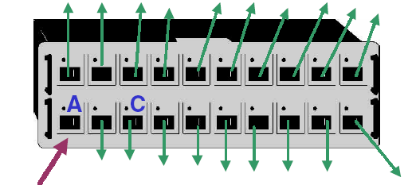
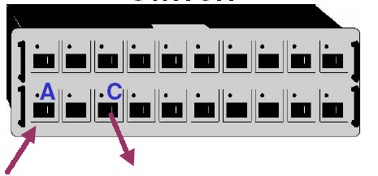
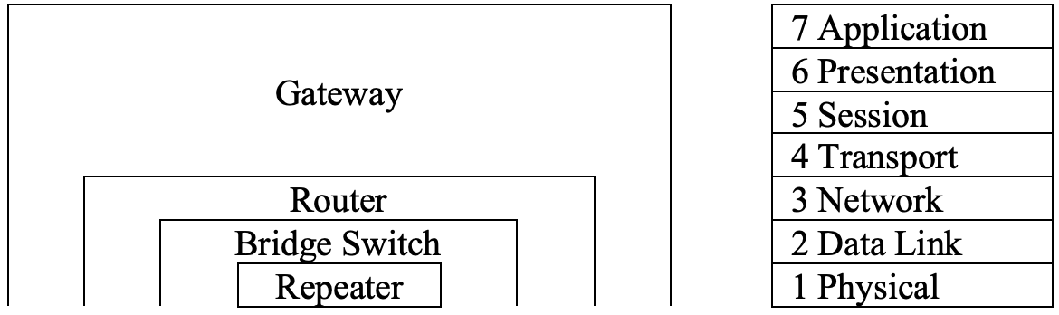
Devices
BLM3051
Data Communication and Computer Network - 7
Network Devices
Network
Repeater
Bridge
Internetwork
Router
Geçit Gateway
Dr. Öğr. Üyesi Furkan ÇAKMAK

Slide 15
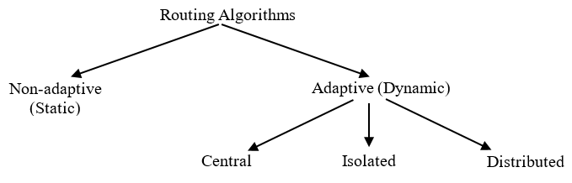
Network Layer – Routing Algorithms Static and Dynamic Routing
BLM3051
Data Communication and Computer Network - 7
Static Routing Algorithms
The route is decided according to the using topology.
Dynamic Routing Algorithms
Monitoring network changing
It is possible to react very quickly even to instant changes.
Central DRA
Collection of data to a central station
It is used in networks where topology and traffic density do not change very frequently.
Dr. Öğr. Üyesi Furkan ÇAKMAK

Slide 16
Network Layer – Routing Algorithms Static and Dynamic Routing (Con’t)
BLM3051
Data Communication and Computer Network - 7
Dynamic Routing Algorithms
Isolated DRA
Not complicated as central DRA
Not create additional traffic on the network.
Hot Patato
Backward Learning
Distance Vector Routing
Flooding
Distributed DRA
Exchanging available information with neighbors
Link State
Dr. Öğr. Üyesi Furkan ÇAKMAK

Slide 17
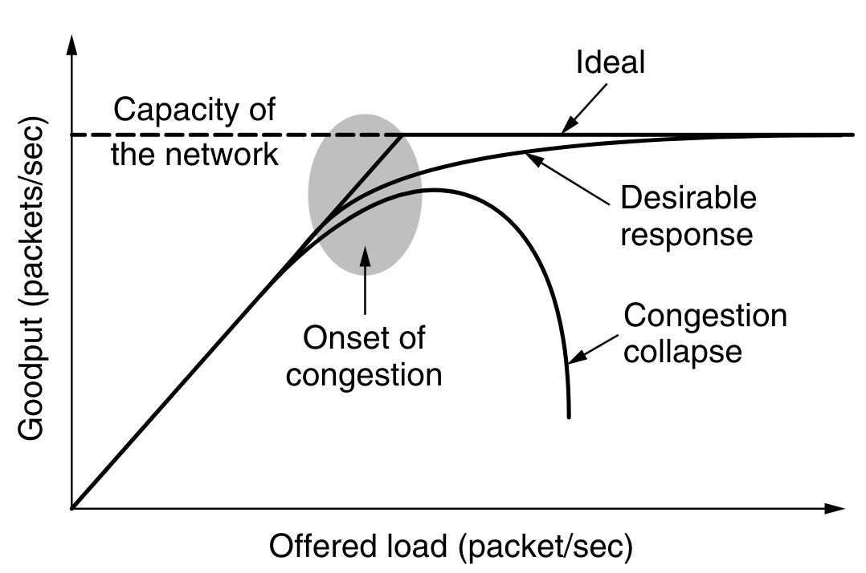
Congestion in the Network Layer, Its Causes and Solutions
BLM3051
Data Communication and Computer Network - 7
The network and transport layers share the responsibility for handling congestion
Congestion occurs within the network
Routers’ buffers
The low bant traffic
Congestion control and flow control relationship
Approaches to Congestion Control
The presence of congestion means that the load is greater than the resources can handle.
Increase the resources
Decrease the load.
* Andrew S. Tanenbaum - Computer Networks
Dr. Öğr. Üyesi Furkan ÇAKMAK

Slide 18
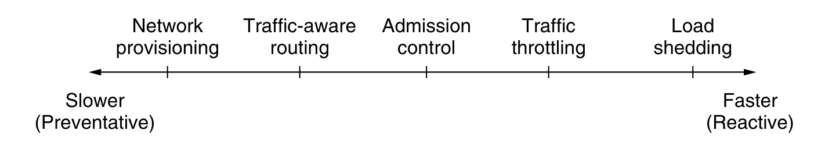
Congestion in the Network Layer, Its Causes and Solutions (Con’t)
BLM3051
Data Communication and Computer Network - 7
Network Provisioning
Traffic-Aware Routing
Admission Control
Traffic Throttling
Choke Packet
Explicit Congestion Notification
Hop-by-Hop Backpressure
Load shedding
* Andrew S. Tanenbaum - Computer Networks
Dr. Öğr. Üyesi Furkan ÇAKMAK

Slide 19
Thank you for your listening.
BLM3051
Data Communication and Computer Network - 7
Dr. Öğr. Üyesi Furkan ÇAKMAK

